Slide 1
PULMONARY REGURGITATION-
SEVERITY ASSESSMENT
- fazil bishara

Slide 2
Determination of the severity of PR is less validated than that of AR, largely due to the lack of reliable standards for comparison!
-Imaging the pulmonic valve is difficult in adult patients.
-Significant PR is not a common condition

Slide 3
PR, especially in its trace or mild form, is mostly a physiological finding in normal heart.
The pathological form tends to have a longer duration of flow and a wider jet.
Pathologic PR, most often is the consequence of prior interventions for congenital heart disease- as with TOF repair with placement of an outflow tract patch or valvotomy for isolated congenital PS

Slide 4
JET LENGTH & JET WIDTH-
The pulmonary regurgitant jet length is commonly used as a measure of PR with a length of 10 mm or less beyond the pulmonary annulus considered to be trace.
The proximal jet width is probably a more reliable method for determining PR degree- maximum colour jet diameter in diastole immediately below the pulmonary valve in PSAX view.
Severe PR – if a jet width >65% of the RVOT measured in the same plane

Slide 5
PR severity is generally determined by jet size and duration and pathological PR is typically a wide holo-diastolic jet.
However, in severe PR, equalization of PA and RV pressure early in diastole, cause early and abrupt cessation of colour and and continuous wave doppler jet!
Reliance on the colour flow jet alone- lead to under-appreciation of the PR severity!!!

Slide 6
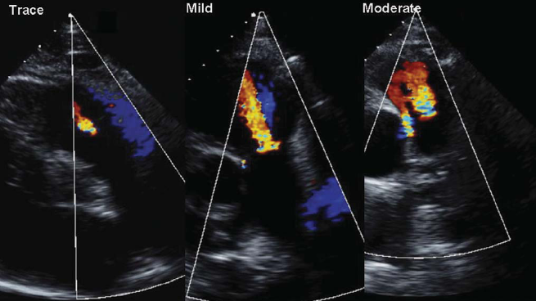

Slide 7
The density and contour of the CW doppler signal and deceleration PHT correspond to the degree of PR and RV pressures.
Equal intensities of antegrade and retrograde flow across the pulmonic valve suggest severe PR

Slide 8
Severe PR is often best demonstrated by PW Doppler in which there is rapid deceleration of the slope (PHT<100) of the pulmonary regurgitation Doppler profile and often laminar flow is present because of non-obstructed pulmonary regurgitant flow.
In lesser degrees of PR, the spectral Doppler pattern is turbulent, reflecting disorganized velocities across the valve.

Slide 9
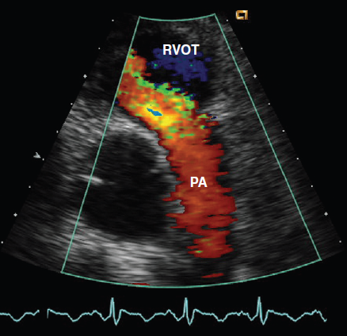
Color Doppler evaluation of the pulmonic valve in a PSAX view shows laminar flow filling the RVOT in diastole, consistent with severe pulmonic regurgitation.

Slide 10
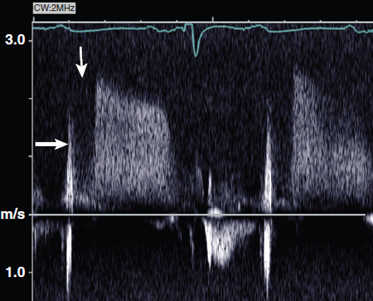
The signal is much less dense than antegrade flow and the slow deceleration, consistent with mild PR.

Slide 11
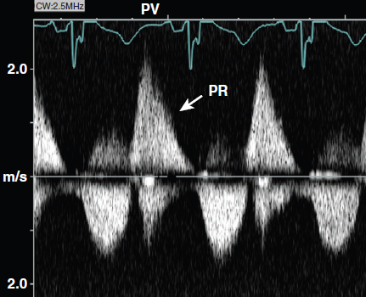
The density of retrograde flow across the valve (above the baseline) is equal to the density of antegrade flow in systole and the rapid deceleration indicating severe PR

Slide 12
other determinants of severity
Vena-contracta width is the smallest regurgitant flow area immediately beyond the flow convergence region.
Because the pulmonary artery is a low pressure system and there is no constraining regurgitant orifice, a classic convergent zone, vena-contracta and downstream jet may not be easily visualized!
EROA: <20 sq.mm: mild
21-115: moderate
>115: severe

Slide 13
PR jet-width/ pulmonary annulus ratio > 1:2
Diastolic reversal of flow in main or branch PA
PRi (pulm.regurgitation index)-the ratio of duration of PR to that of the total diastole from CWdoppler trace <0.77 correlated with severe PR
Other indirect evidences of PR severity includes- RV size and function

Slide 14
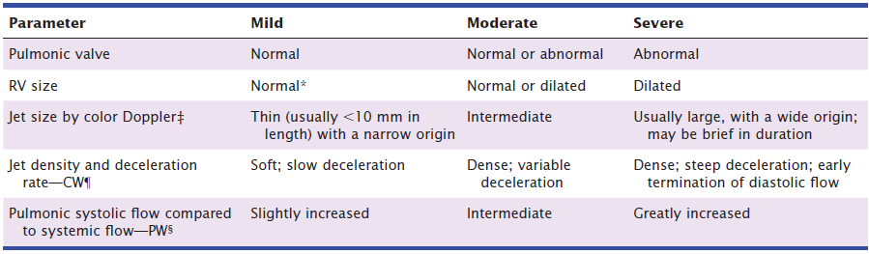
Echocardiographic and Doppler Parameters Used in Grading Pulmonary Regurgitation Severity-

